Slide 1

Created By: Naseer Alshnawa

Slide 2


Background
Objectives
Approach
Methodology & Analysis Result
Recommendations
Appendix

Slide 3
Background AAA Northeast is one of the regional clubs comprising the American Automobile Association, covering Rhode Island, Connecticut, Massachusetts and portions of Rhode Island, Connecticut States. AAA Northeast offer services such as roadside assistance, maps, and various discounts as part of their services.
• Roadside assistance is a costly benefit, particularly towing. Members who frequently use roadside assistance are less desirable. • AAA also offers other paid services at highly competitive prices. They also offer insurance, travel and banking/loan products. AAA would like to increase the penetration of these services.

Slide 4
Objectives Provide a market segmentation of AAA members at household level for AAA Northeast to better serve their members. This analysis would allow AAA to:
Better anticipate the needs of members.
Customize communications and offering to various segments.
Expend more effort driving acquisition and renewal of desirable members

Slide 5
Approach • Data Understanding • Problem Definition & Solution

Slide 6
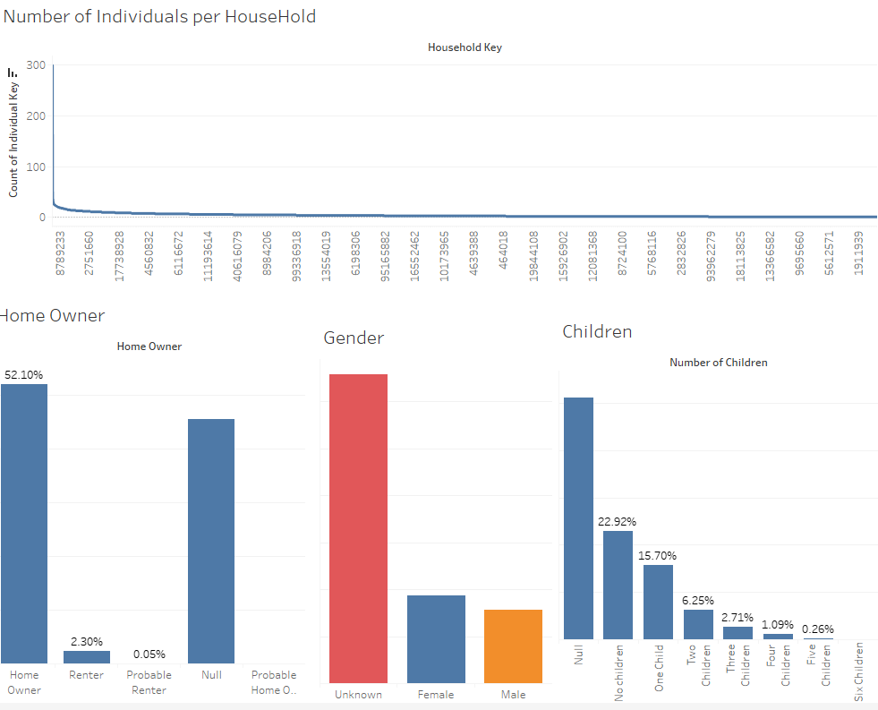
Data Understanding
Strong identifiers :
Children = Unknown
Gender = Unknown
Homeowner = Unknown
Number of Individuals per HouseHold

Slide 7
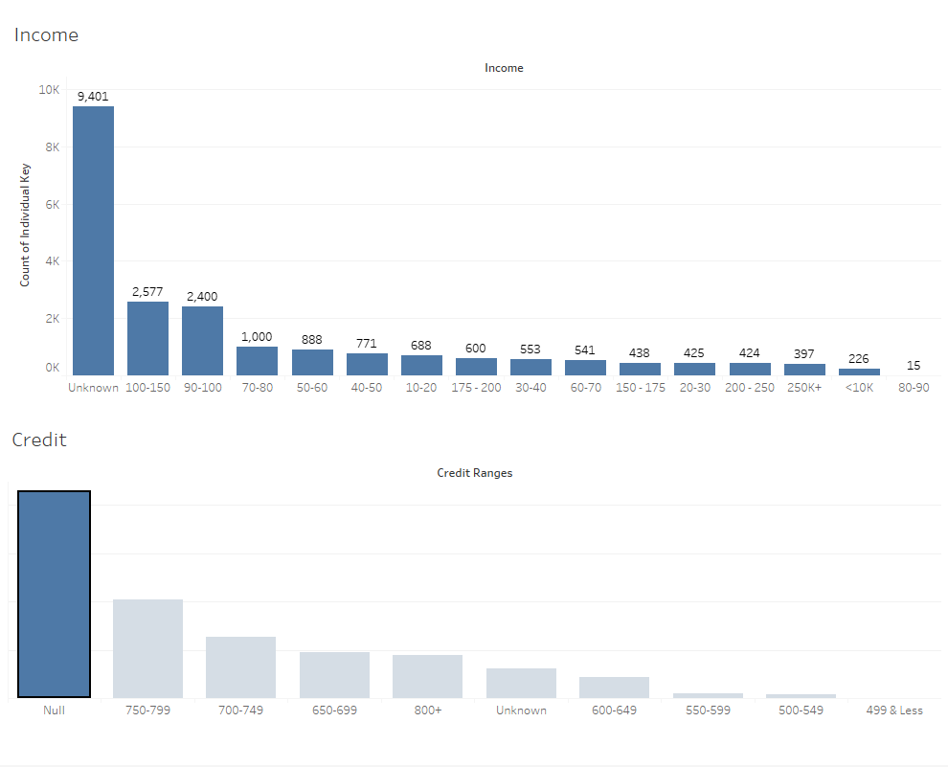
Data Understanding
Strong Household credit and income :
Credit = Unknown
Income = Unknown

Slide 8
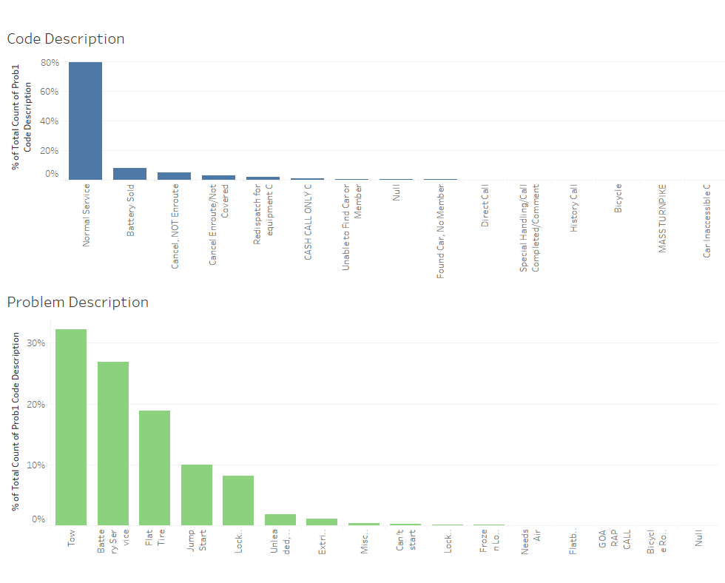
Data Understanding
Majority of Service usage:
80% Normal Services and 20-30 % for it is Towing, Battery and Flat Tiers Services

Slide 9
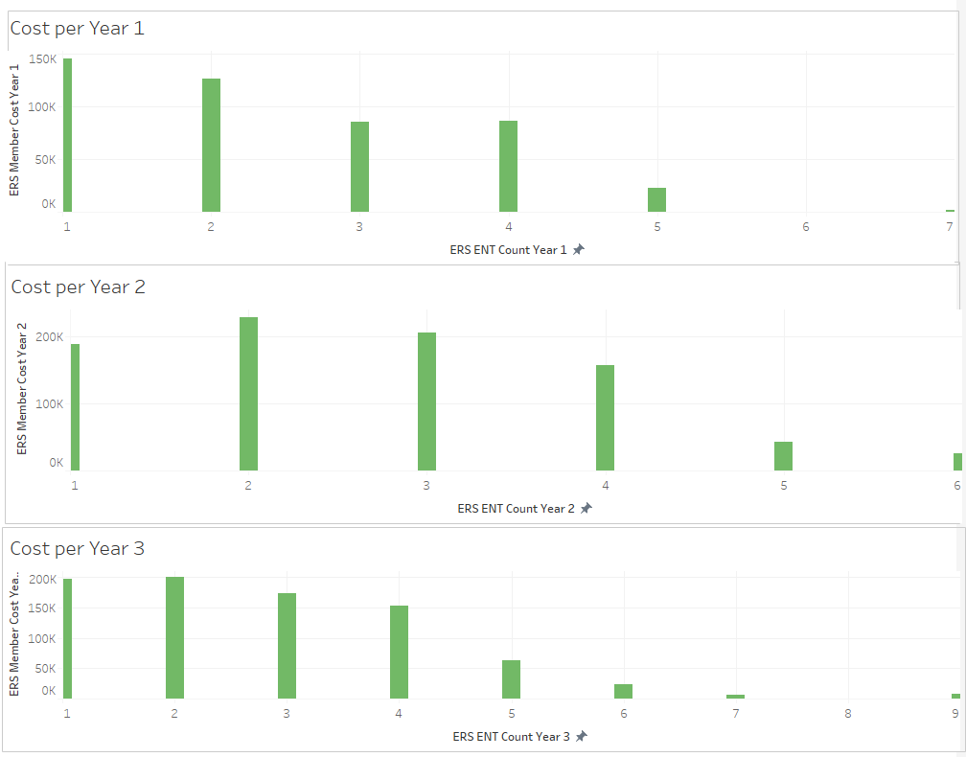
Data Understanding
Cost and number of services for the last 3 years

Slide 10
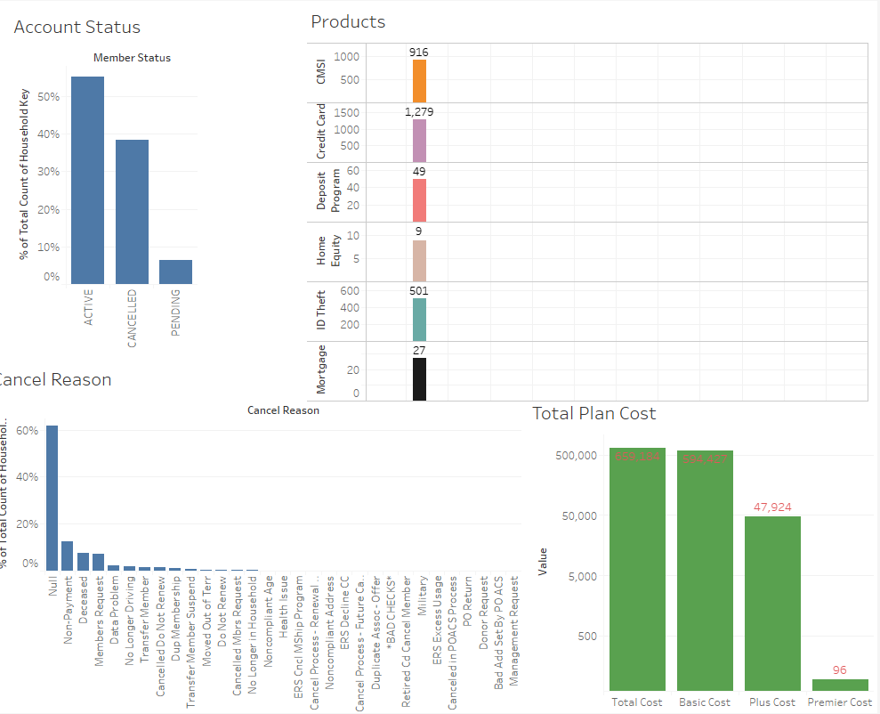
Data Understanding
More information:
Account Status and Cancel reason.
Number of subscribers for each Service.
Products Cost.

Slide 11
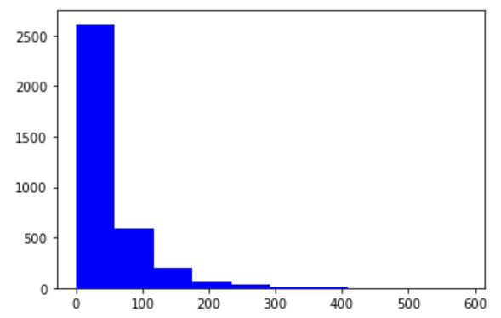
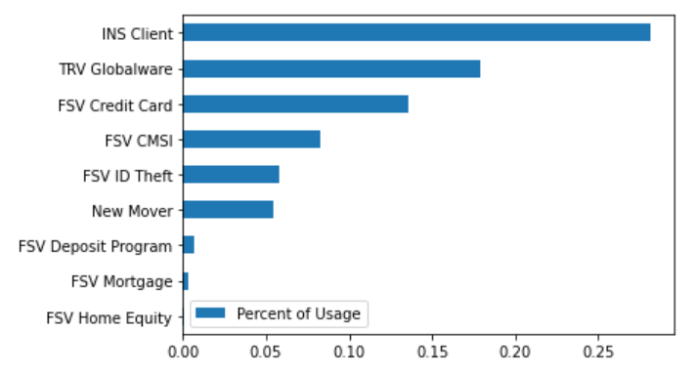
Data Understanding
Cost
Revenue
AAA’s households cost are less than 35%,
65% households didn't generate any costs in 2019.
AAA products have low market.
The highest used product is less than 30% of the household.
Segmentation
Number of products bought | Number of household
0.0 | 1589
1.0 | 1220
2.0 | 539
3.0 | 135
4.0 | 25
5.0 | 3
Around 45% of the households did not subscribe to other AAA products and there is a big market opportunities

Slide 12
Problem Definition & Solution
Cost
Revenue
Problem statement: How likely will the members to subscribe
to other AAA’s financial product in the next 12 months?
Solution: Predictive models to Forecast the probability of
generating cost for the next 12 months
Problem statement : How likely are the members to purchase AAA’s financial products?
Solution: Predictive models to Predict probability of purchasing a product
Segmentation
Problem statement: How to target members and achieve highest Return on investment?
Solution: Clustering based on predicted probabilities of purchasing products and generating cost
by Explore the market opportunities to maximizes the Return on investment.

Slide 13
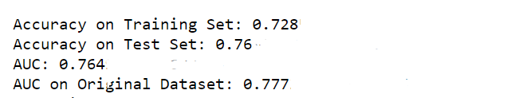
Analysis Result
Cost
Forecast Cost in the Next 12 Months
Time-Relevant Variables: Use the cost before year 2019 as year n-1, n-2, and so on to predict the cost in year 2019. Afterwards, treat year 2019 as year n-1, year 2018 as year n-2, and so on to predict the cost in year 2020.
Assumption: The household information would remain the same in year 2020
Best Model: Bagging + Decision Tree

Slide 14
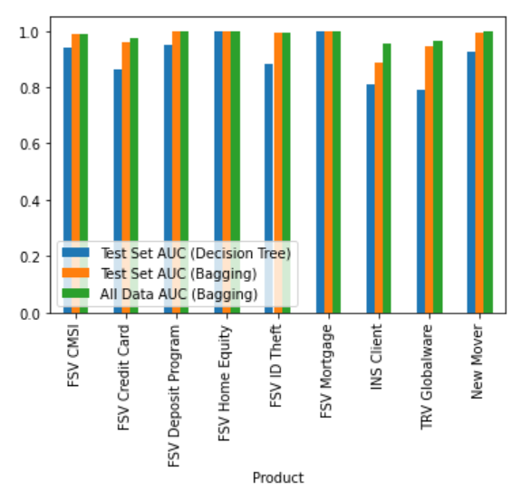
Analysis Result
Revenue
Predict Probability of Purchasing a Product
Best Model: Bagging + Decision Tree
Prediction Power on Probability (AUC):
Test Set (Decision Tree) 0.911474
Test Set (Bagging): 0.975726
All Data (Bagging): 0.986834
With high AUC on predicting all products, we can be confident that the probability of purchasing would be a good reference on potential buyers for each product.

Slide 15
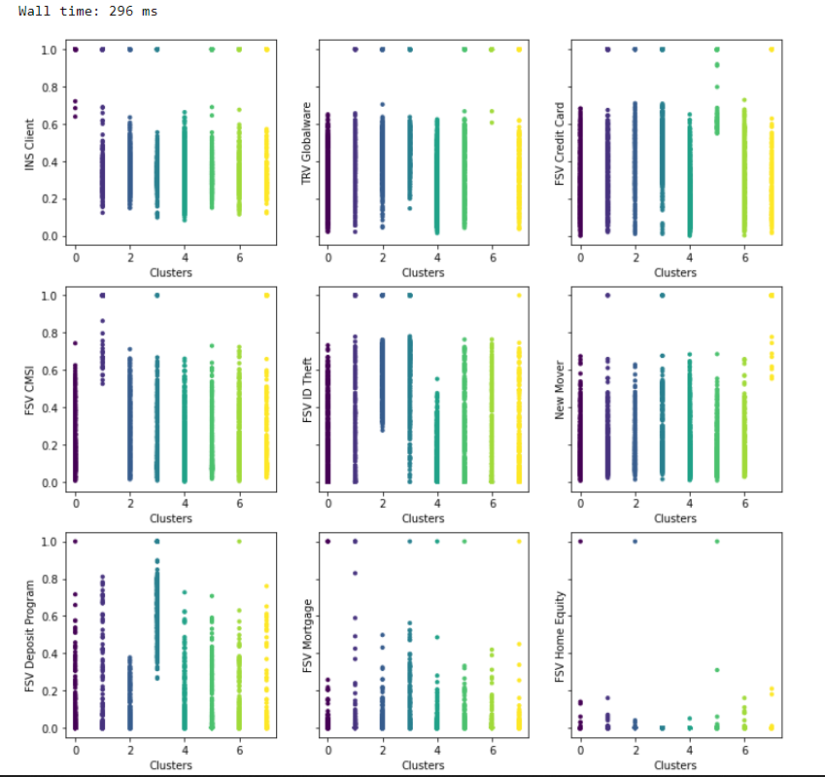
Analysis Result
Segmentation Number of Segments
Market Opportunities: When the households are clustered into 8 or 9 groups,
we can identify target groups with high interest on a particular product for 7 products.
Therefore, it seems 8 is an ideal number of clusters

Slide 16
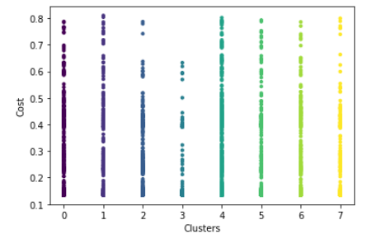
Analysis Result
Segmentation – Cost across Segments
Market Opportunities: Predicted probability of cost does not show noticeable difference across clusters.
One reason might be that cost is generated randomly as customers only need road service in emergency.
It is also possible that cost is hard to predict.

Slide 17
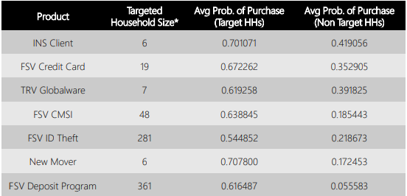
Recommendations 1. Use the segmentation result to target HHs that have particularly high interest on a certain product. 2. Based on HH profile to make tailored product strategies 3. Focus customized product strategy on top 7 popular products 4. Collect more information for cost prediction or conduct more exploration analysis on the pattern of cost.
Segmentation – Cost across Segments
• The table summarizes the size of potential HH for each product.
• Each segment represents a target group that is much more likely
to purchase the product than the others.
The households that have purchase the product are excluded.

Slide 18
Appendix
Data Preprocessing
Data Cleaning:
• Remove cancelled members
• Transform Income/Credit Ranges/Number of Children to numeric data.
Feature Engineering:
• Aggregate cost by year to create new cost variables – cost in 2014, cost in 2015, and so on
• Count number of member type by Household
Granularity – Household Level:
• Use sum or mean of numeric data
• Use mode for non-numeric data on variables that are consistent within Household
• Fill in missing value with median

Slide 19
Appendix
Challenges and Modeling Process
Predict Probability of Purchasing a Product
The data was Unbalanced and was fix by using Up-Sampling, clean data used to train/test the models
to Optimize and Select Best Single
Process & Model : Decision Tree and Bagging on Optimized Decision Tree
Forecast Cost in the Next 12 Months
Data was not normally distributed, its effect the cost prediction and has low performance (RMSE)
Solution: Modify question and predict whether a customer will generate cost
Process & Model:
• Train and Test Models
• Optimize and Select Best Single Model: Decision Tree
• Apply Bagging on Optimized Decision Tree
Explore Market Opportunities
Process & Model:
• Gather data used for segmentation:
Probability of purchasing each product
Probability of generating cost in the next 12 months
• Apply K-Means Clustering

Slide 20
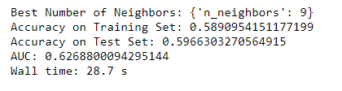
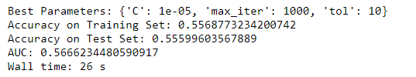
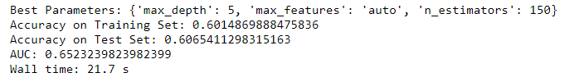
Appendix
Results from Other Models
Performance of other models tried for product prediction, using 'INS Client' as an example.
kNN
Logistic Regression
SVM

Slide 21


